Slide 1

Programming Learning App for Kids
R24-109

Slide 2

Research Problem
Sri Lanka is facing a USD price hike [1], impacting several sectors still recovering from the pandemic [2].
Fortunately, IT Sector is still good in Sri Lanka.
Increased outsourcing from larger companies to South Asian countries, primarily India, presents potential challenges [3].
India's large pool of young talent contributing to open-source projects is a potential competitor [4].
Potential knowledge gap between Sri Lankan Teenagers and Indian Teenagers.

Slide 3

Research Questions ?
How to provide a basic knowledge of programming to kids ?
How to evaluate and examine the kids ?
How to assist kids when they are getting doubts?
How effective is the machine learning model in analyzing students and assigning relevant projects?

Slide 4

Objectives
Main Objective
The primary research objective is to bridge the knowledge gap between our country's students and Indian students, with a focus on producing high-quality and knowledgeable engineers.
Sub Objectives
Exploratory Analysis of Interactive Programming Concepts for Learning
Evaluation and Grading Mechanism Analysis
Assist kids through a Customized Kids Assistance System.
Teach kids how to progress by a Project-based Programming System.

Slide 5
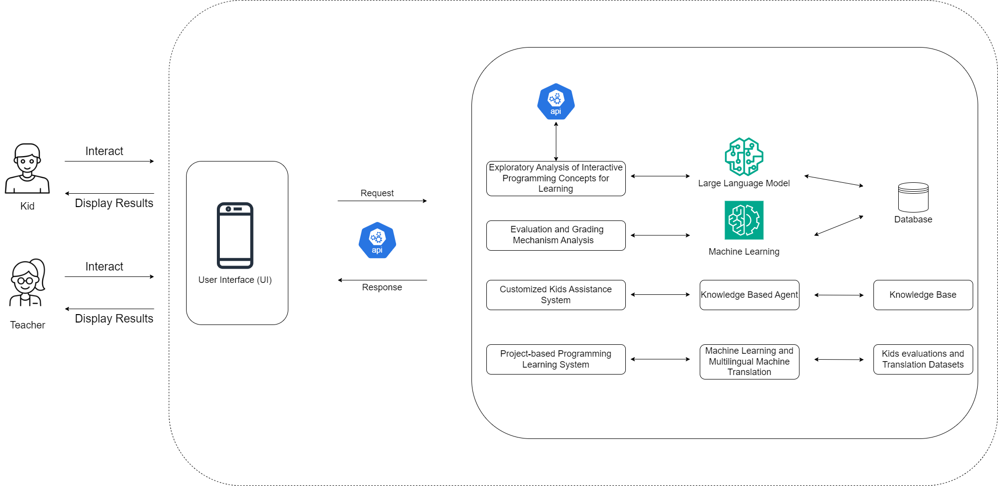
System Diagram

Slide 6

IT21023446 | Sanjeevan m.c.m.a
Software Engineering Specialization
IT21023446 | Sanjeevan M.C.M.A | R24-109

Slide 7






Research Question
Does an interactive mobile application utilizing storytelling and gamification techniques effectively enhance children's understanding of fundamental programming concepts in the learner's native language compared to traditional learning methods?
IT21023446 | Sanjeevan M.C.M.A | R24-109

Slide 8
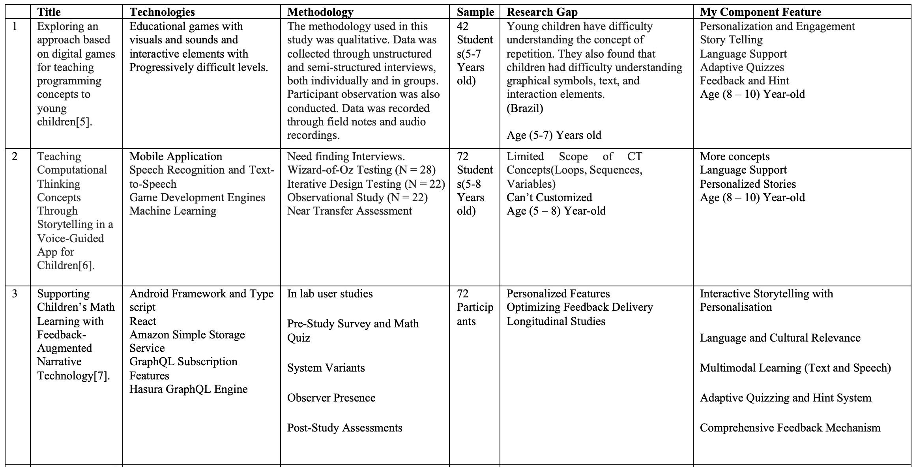
Research Gap
IT21023446 | Sanjeevan M.C.M.A | R24-109

Slide 9
Specific & Sub Objectives
Develop an interactive mobile application for gamified learning of fundamental programming concepts through storytelling using native language support.
Story Generation Module
MCQ Generation Module
Hint Generation Module
Feedback Generation Module
IT21023446 | Sanjeevan M.C.M.A | R24-109

Slide 10
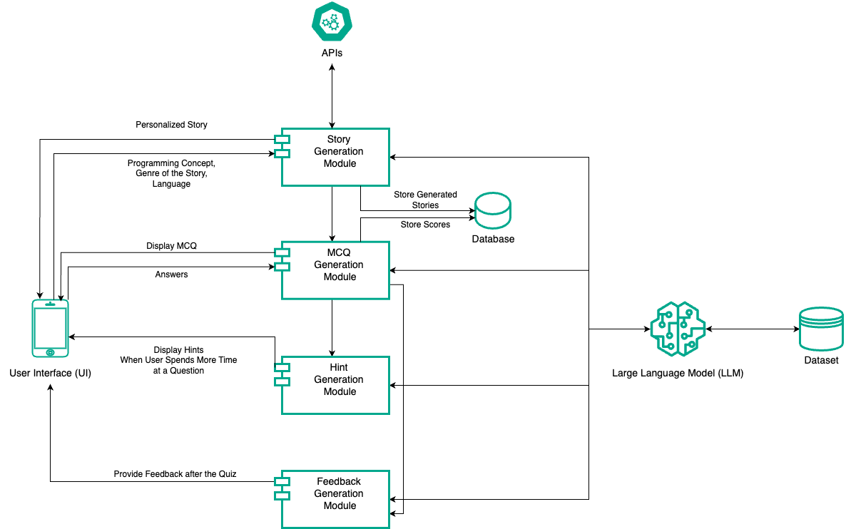
Methodology
System Diagram
IT21023446 | Sanjeevan M.C.M.A | R24-109

Slide 11

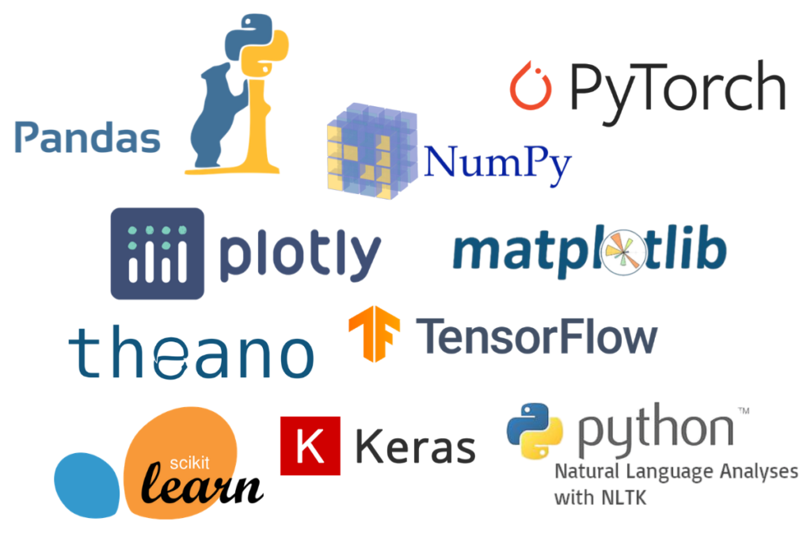



Methodology Cont’d
Technologies Used
Flutter
Spring boot / JavaScript
Firebase / MongoDB
LLM
Open AI API
Open AI Python Library
Text to Speech Library (Tamil)
IT21023446 | Sanjeevan M.C.M.A | R24-109

Slide 12
Methodology Cont’d
System Requirements
Functional Requirements | Non Functional Requirements
User Registration and User Profile creation | Performance
Programming concepts Integration | Scalability
Story Customization | Acessability
Language Support | Security
Feedback Generation | Content Quality
Hint System | Reliability
IT21023446 | Sanjeevan M.C.M.A | R24-109

Slide 13
Methodology Cont’d
Personal Requirements
Effective team communication
Collaborative Problem-Solving
Continuous learning and improvement
Adaptability and flexibility
Respectful and supportive team dynamics
IT21023446 | Sanjeevan M.C.M.A | R24-109

Slide 14
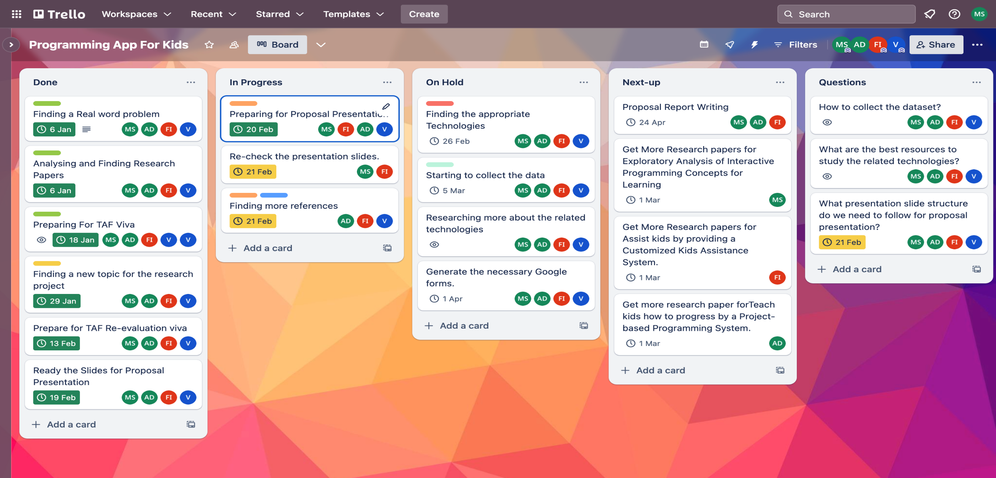
Methodology Cont’d
IT21023446 | Sanjeevan M.C.M.A | R24-109

Slide 15
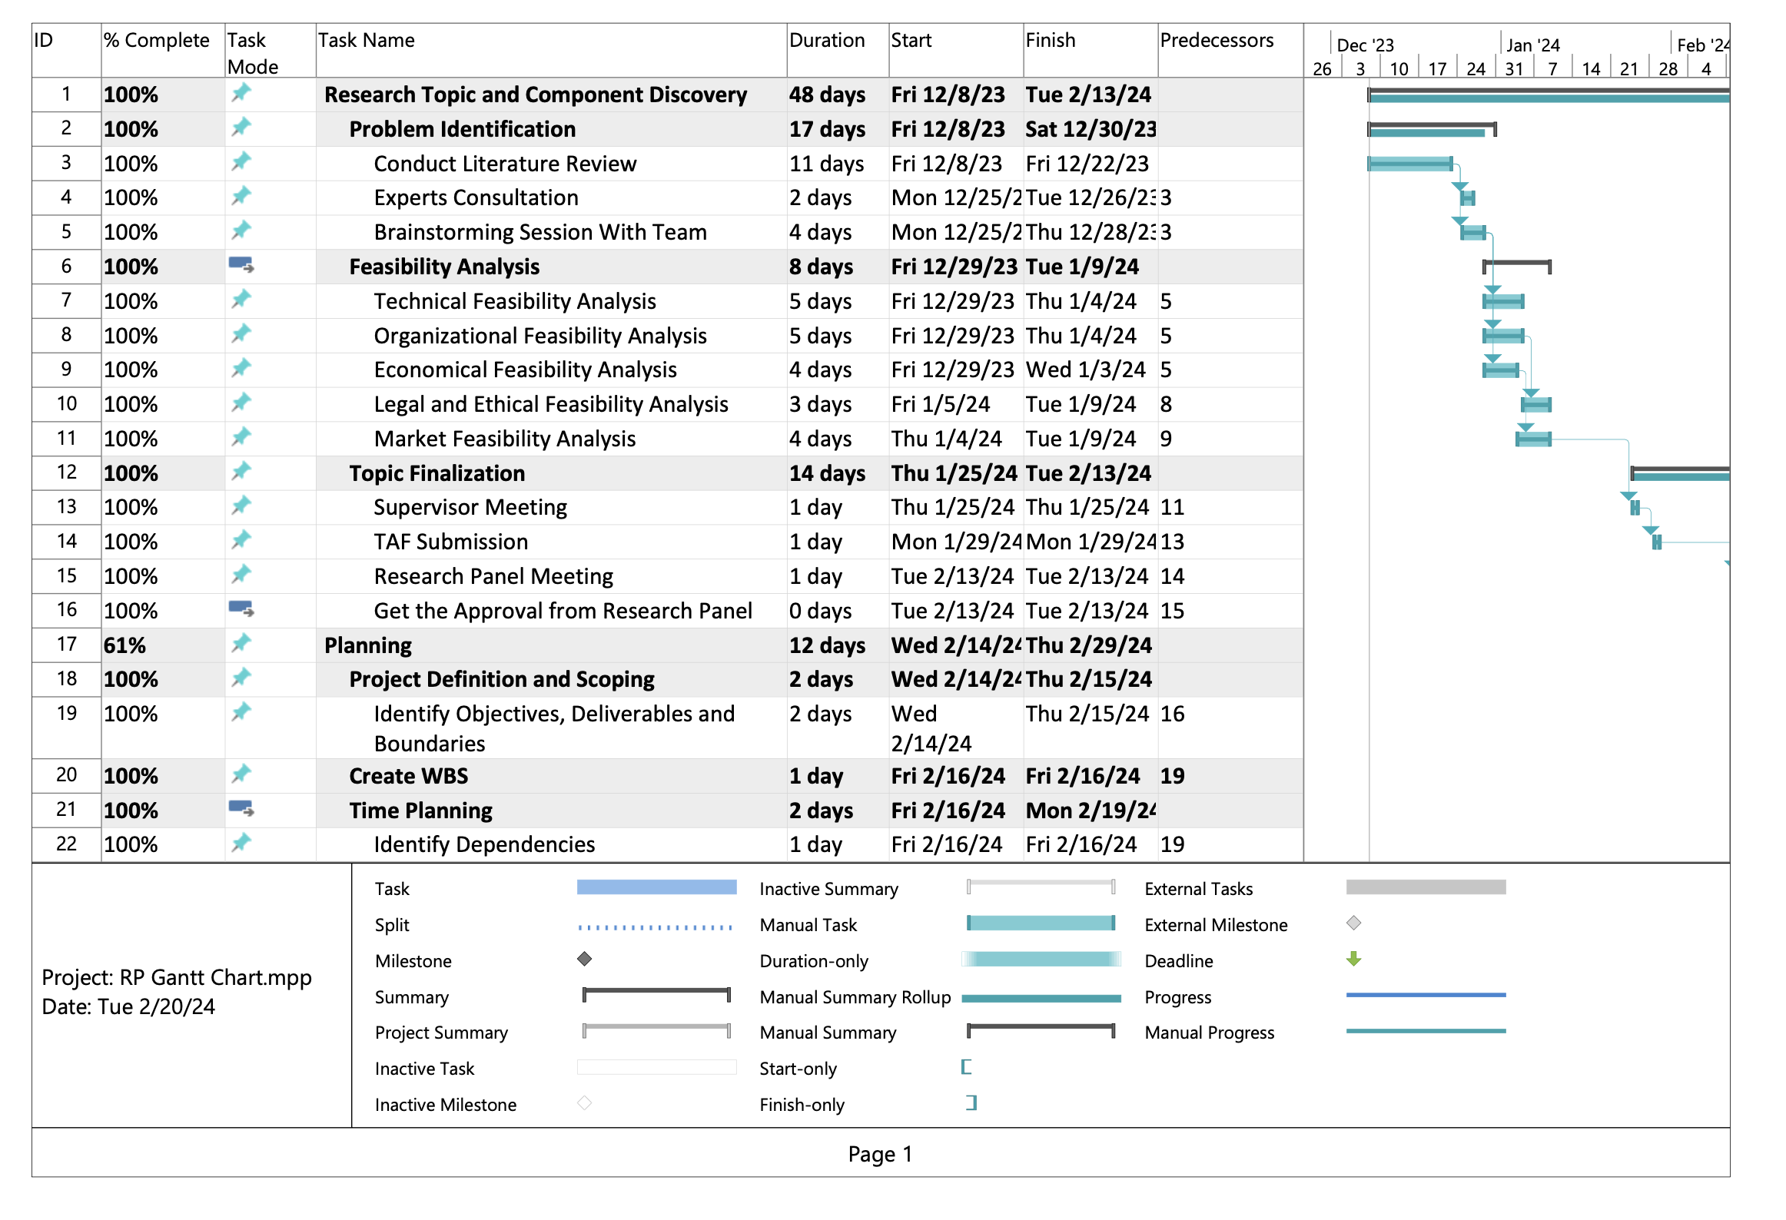
Methodology Cont’d
Gannt Chart
IT21023446 | Sanjeevan M.C.M.A | R24-109

Slide 16
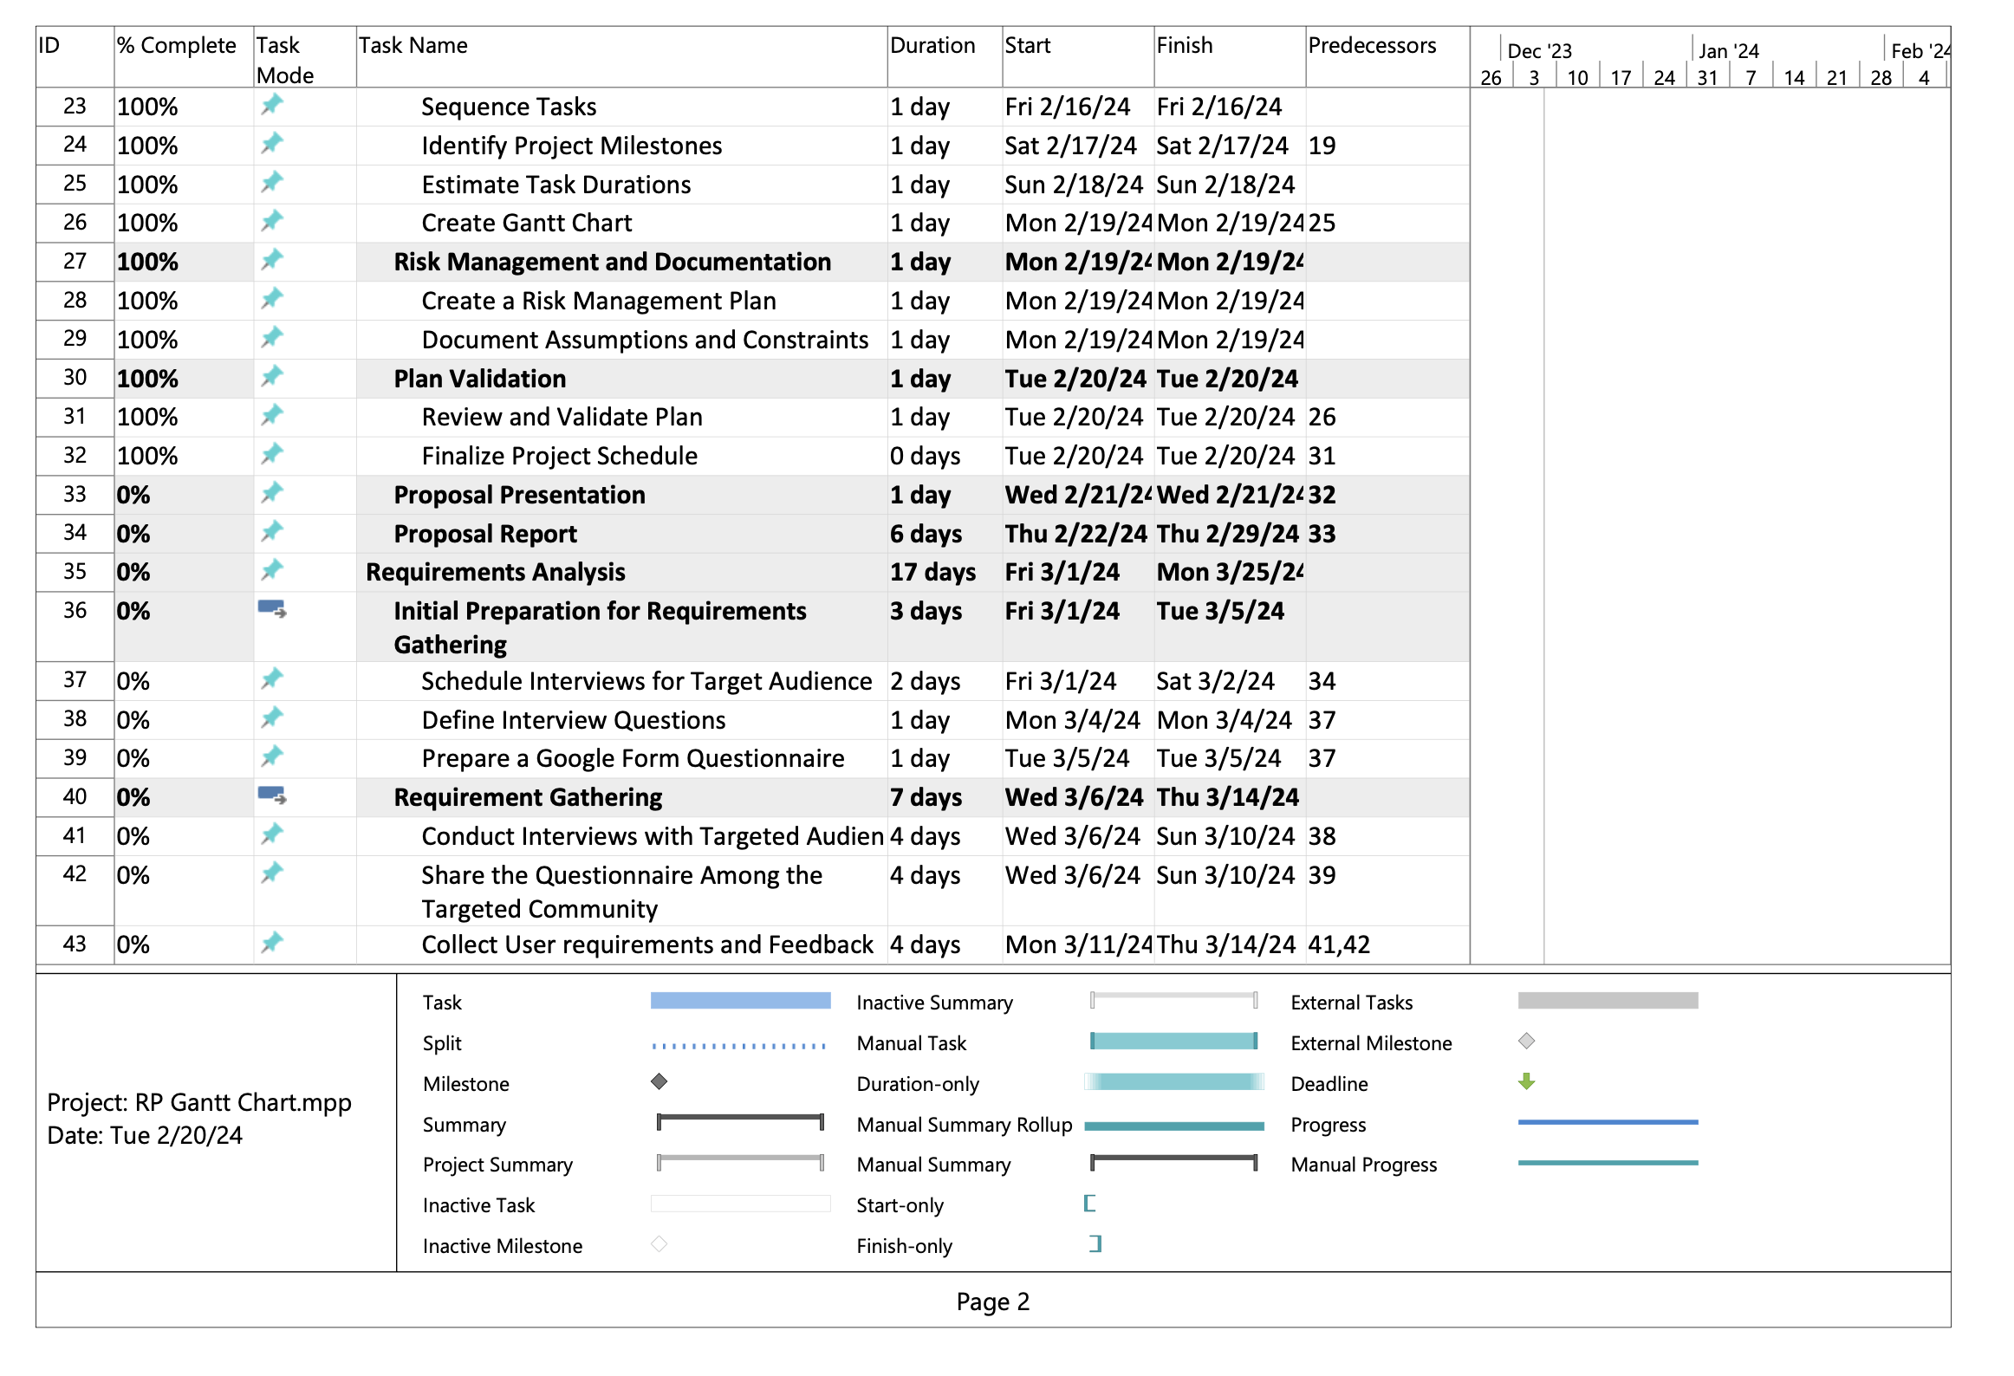
Methodology Cont’d
IT21023446 | Sanjeevan M.C.M.A | R24-109

Slide 17

Supporting Items
Commercialization
Offer a subscription-based model
Licensing and Partnerships
Share on social media add
Make it shareable
Provide an accurate description of our product
IT21023446 | Sanjeevan M.C.M.A | R24-109

Slide 18
Supporting Items
Budget
NO | Expenditure | Cost ($)
1 | Domain | 14.43$/M
2 | Hosting | 2.99$/M
3 | Traveling Expenses (4 Members ) | 12.84$/Trip
4 | Google Play Developer Fee | 25$ (One Time)
Total |  | 55.26$
IT21037306 | Fahmi M.F.A. | R24-109

Slide 19
References
[5] Simões Gomes, Tancicleide Carina, et al. “Exploring an Approach Based on Digital Games for Teaching Programming Concepts to Young Children.” International Journal of Child-Computer Interaction, vol. 16, June 2018, pp. 77–84, https://doi.org/10.1016/j.ijcci.2017.12.005.
[6] Dietz, G., Le, J. K., Tamer, N., Han, J., Gweon, H., Murnane, E. L., & Landay, J. A. (2021). StoryCoder: Teaching computational thinking concepts through storytelling in a voice-guided app for children. In Proceedings of the 2021 CHI Conference on Human Factors in Computing Systems (pp. 1-15). ACM. [doi:10.1145/3411764.3445039]
[7] Ruan, S., He, J., Rui, J., Burkle, J., Hakim, D., Wang, A., Yufeng, L., Zhou, L., Xu, Q., AbuHashem, A., Dietz, G., Murnane, E. L., Brunskill, E., & Landay, J. A. (2020). Children's math learning with feedback-augmented narrative technology. In Proceedings of the 2020 ACM Conference on Human-Computer Interaction (pp. 567-580). ACM. [doi:10.1145/3334423.3377805]
[8] Maloney, J., Resnick, M., Rusk, N., & Silverman, B. (2008). The design and evaluation of programming systems for children. In CHI '08 Proceedings of the SIGCHI Conference on Human Factors in Computing Systems (pp. 1025-1034). ACM
[9] Garcia, P., Glassman, E., [et al.] (2022). "An Empirical Study of Mobile Programming Environments for Young Children," IEEE Transactions on Learning Technologies, 14(3), pp. 456-469.
IT21023446 | Sanjeevan M.C.M.A | R24-109

Slide 20
References Cont’d
[10] M. Videnovik, A. M. Bogdanova, and V. Trajkovik, "Game-based learning approach in computer science in primary education: A systematic review, vol. 1, no. 100616, Jan. 2023. [Online]. Available: https://doi.org/10.1016/j.entcom.2023.100616
[11] "Improving Teaching and Learning Computer Programming in Schools through Educational Software." Olympiads in Informatics, vol. 11, pp. 55-75, 2017, doi:10.15388/ioi.2017.05
[12] Devananda Sreekanth and Dr. Nasrin Dehbozorgi Title: "AI-based Quiz Generation: The Role of LLMs in Digital Education" Conference: C-DAY FALL 2023 Year: 2023 DOI
[13] Abraham Karikari, Emmanuel Opoku Kumi, Ellen Afia Achiaa, and Juliet Adu, "The Impact of Using Mother Tongue as Instructional Language in Teaching and Learning of Mathematics in Rural Primary Schools: A Case Study of four selected Schools in Sefwi Akontombra District, Ghana," International Journal of Novel Research in Education and Learning, vol. 9, issue 1, pp. 26-38, January-February 2022
[14] Smith, J., & Johnson, A. (2023). "Generating Multiple Choice Questions for Computing Courses Using Large Language Models." IEEE Transactions on Education, 10(5), 123-135. DOI: 10.1109/TE.2023.456789.
[15] Z. Zhao et al., "More human than human: LLM-generated narratives outperform human-LLM interleaved narratives," in Proceedings of the 15th Conference on Creativity and Cognition (C&C '23), June 2023, pp. 368-370, doi: 10.1145/3591196.3596612.
IT21023446 | Sanjeevan M.C.M.A | R24-109

Slide 21

IT21037306 | Fahmi M.F.A.
Software Engineering Specialization
IT21037306 | Fahmi M.F.A. | R24-109

Slide 22
Research Questions ?
How to assist kids when they are getting doubts ?
How to get input from kids ?
How to provide the suitable answer for their doubts ?
How to identify the kids questions even those are not properly structed?
What are the ways to provide the answers?
IT21037306 | Fahmi M.F.A. | R24-109

Slide 23
Research Gap
Research Papers | Methodology | Technology | Gap | My Component
Software Agent in E-Learning Mobile Application for Kindergarten Students [16]. | Questionnaire Testing Semi-Structured Interviews Feedback Collection Observational Study | Not Mentioned But They Developed Android App | Not providing a assistance to kids through the app | Providing a proper assistance system through the app.
Learning Math through Mobile Game for Primary School Students [17]. | Designing the Model of Learning Creating User Interface Prototypes | Not Mentioned | Helping kids through communicate via forum. Hard to maintain safety & privacy. Requires lots of human interaction. | Providing a proper assistance system through the app. By using KBA or KBS systems.
Digital Learning For Kids [18]. | Extract the information Sentiment analysis from the text and audio input. | Text to Speech (TTS) Machine Learning Natural Language Processing Web Scraping: | Not providing a assistance to kids through the app | Providing a proper assistance system through the app.
IT21037306 | Fahmi M.F.A. | R24-109

Slide 24
Specific and Sub Objectives
Develop a customized kids' assistance system to provide real-time support for learning challenges by implementing a structured breakdown of identified problems and promote their critical thinking.
Design a interactive and user-friendly interface for kids.
Get the input from kids (Voice / Image) and Transfer it to Text Format.
Translate the text to English if it’s from another language.
Design a flexible and expandable KBA
KBA (Knowledge Based Agent)
Provide a compact problem breakdown structure to kids.
IT21037306 | Fahmi M.F.A. | R24-109

Slide 25
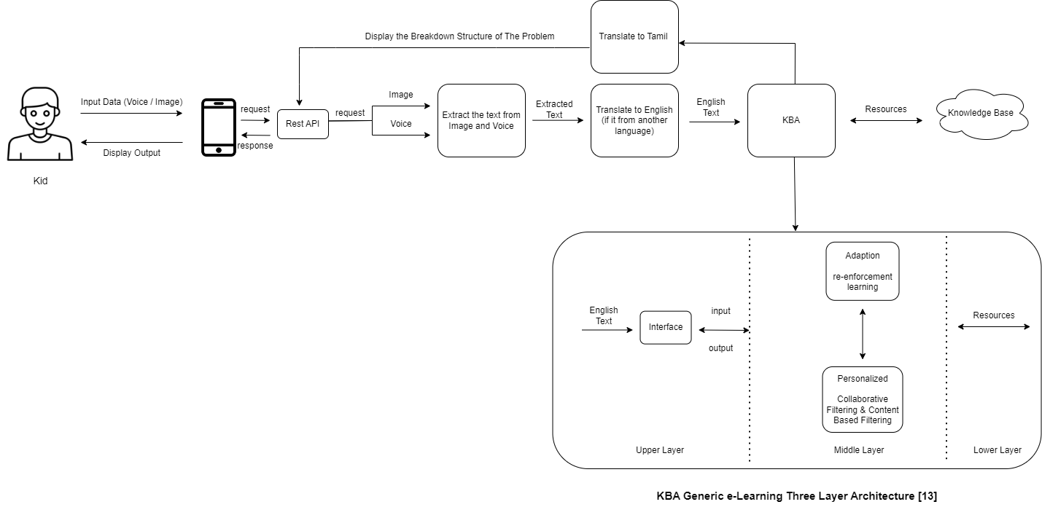
Methodology
System Diagram
IT21037306 | Fahmi M.F.A. | R24-109

Slide 26

Methodology Cont’d
Technologies Used
Flutter
Spring boot / Node JS
Firebase / MongoDB
JAVA
Libraries (Keras, Google Cloud Speech-to-Text and etc. )
Mediawiki, Dokuwiki
IT21037306 | Fahmi M.F.A. | R24-109

Slide 27
Methodology Cont’d
System Requirements
Functional Requirements | Non Functional Requirements
User should be able to input data as image or voice | Performance
User should be able to see breakdown structure of problem | Scalability
User should be able to use English or Tamil language to input data | Reliabilty
User should be able to see the output in Tamil language | Security
IT21037306 | Fahmi M.F.A. | R24-109

Slide 28
Methodology Cont’d
Personal Requirements
Learning and time commitment
Adaptability and flexibility
Respectful and supportive team dynamics
Effective team communication
Collaborative Problem-Solving
IT21037306 | Fahmi M.F.A. | R24-109

Slide 29
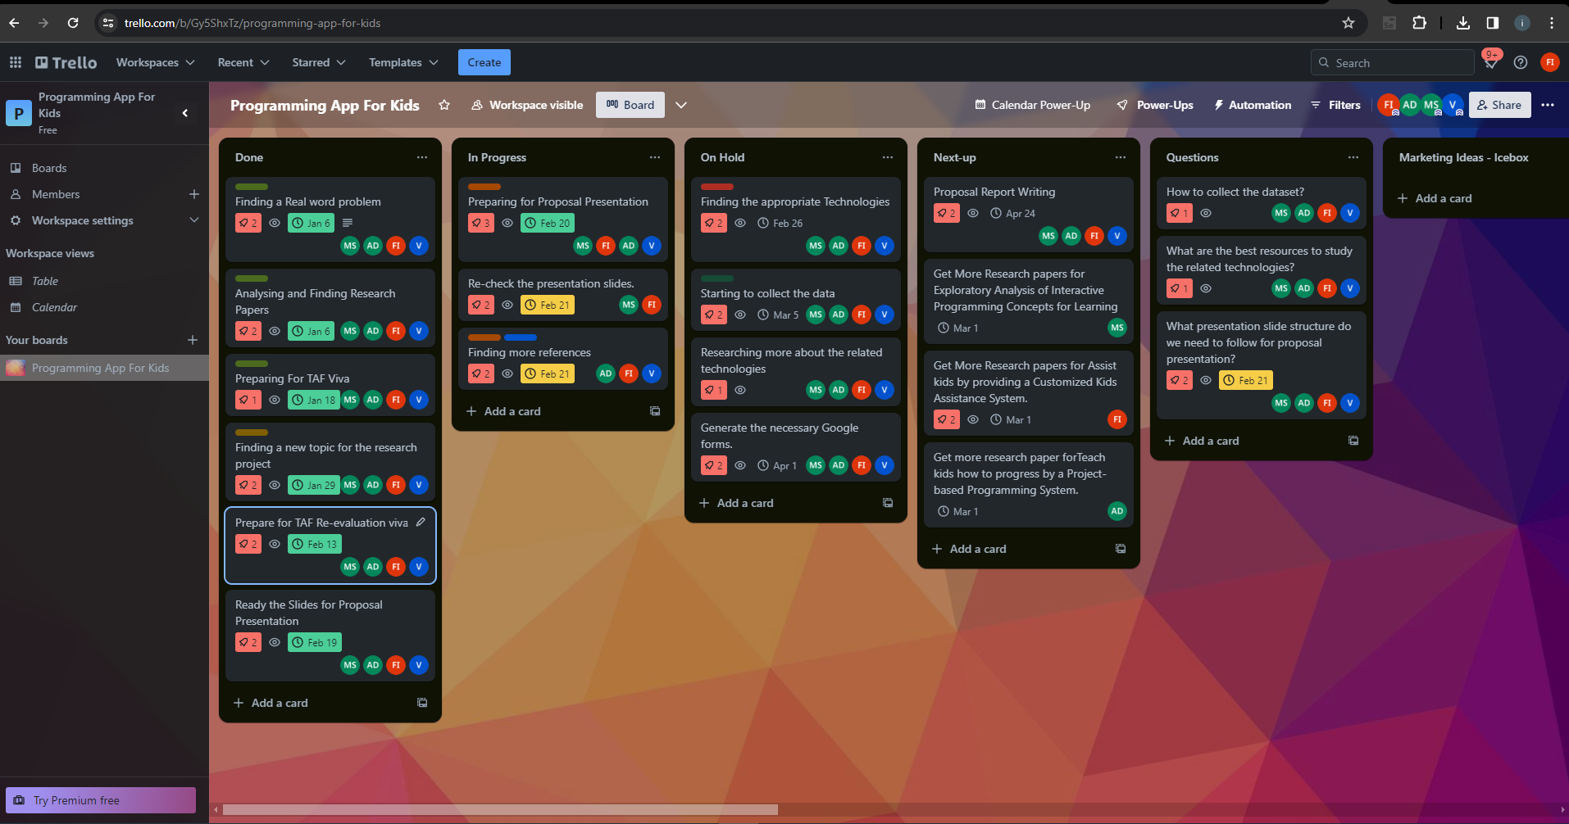
Methodology Cont’d
IT21037306 | Fahmi M.F.A. | R24-109

Slide 30
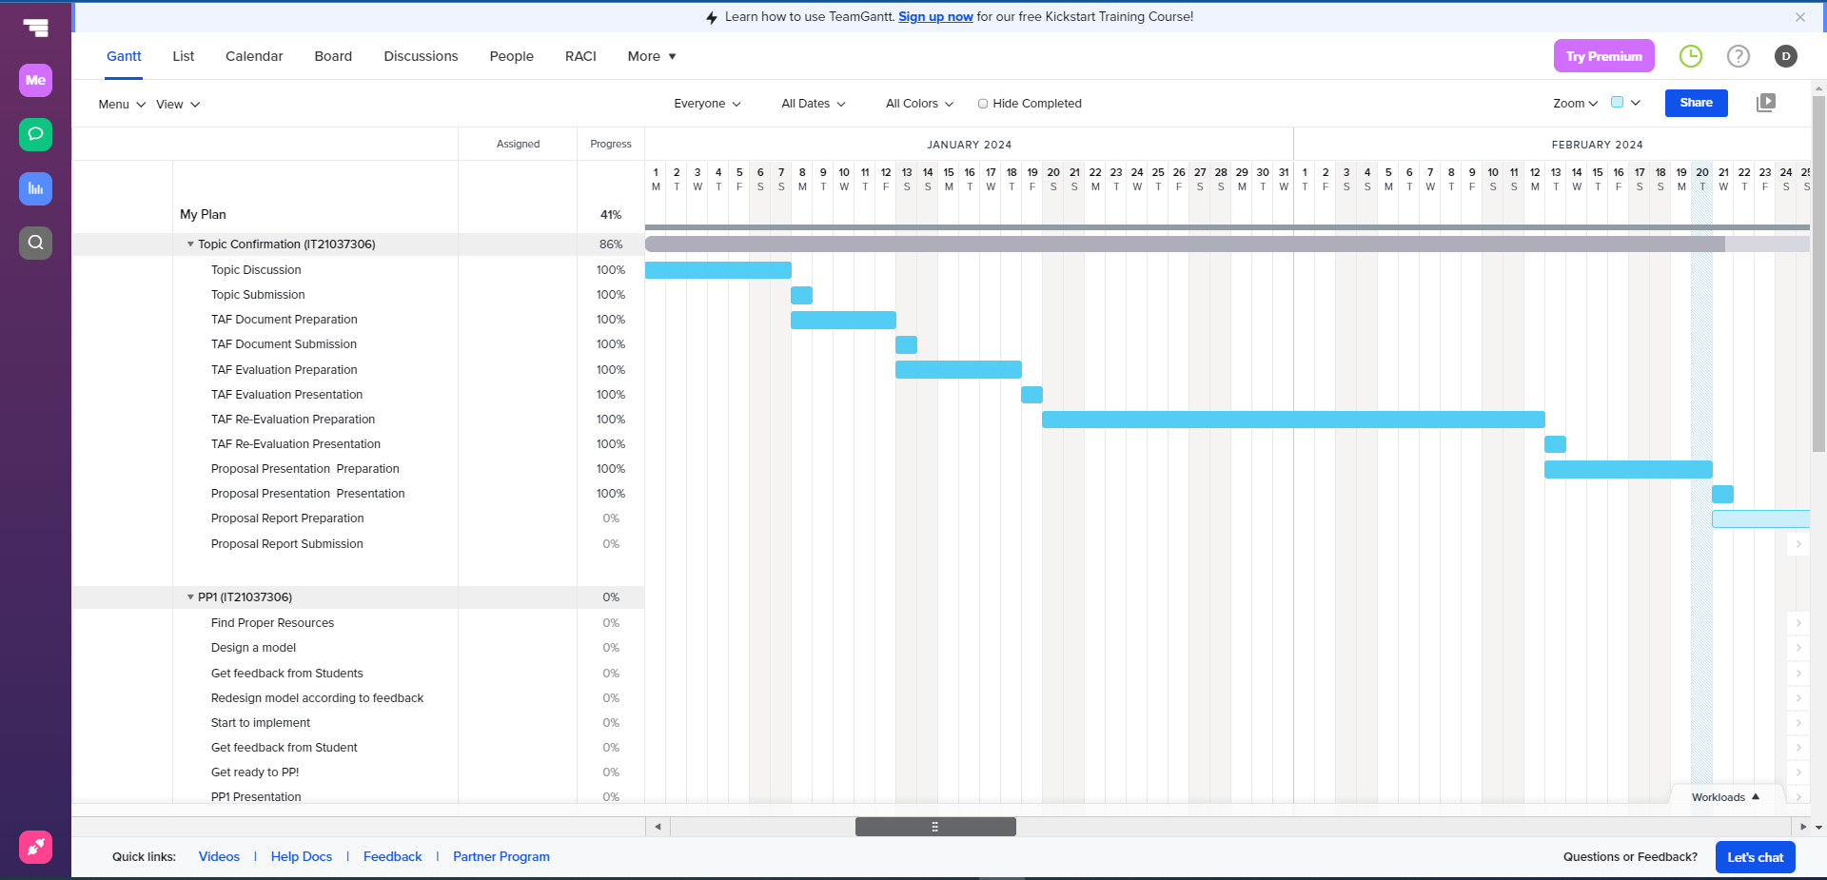
Methodology Cont’d
Gantt Chart
IT21037306 | Fahmi M.F.A. | R24-109

Slide 31
Supporting Items
Commercialization
Offer a subscription-based model
Licensing and Partnerships
Share on social media add
Make it shareable
Provide an accurate description of our product
IT21037306 | Fahmi M.F.A. | R24-109

Slide 32
Supporting Items
Budget
NO | Expenditure | Cost ($)
1 | Domain | 14.43$/M
2 | Hosting | 2.99$/M
3 | Traveling Expenses (4 Members ) | 12.84$/Trip
4 | Google Play Developer Fee | 25$ (One Time)
Total |  | 55.26$
IT21037306 | Fahmi M.F.A. | R24-109

Slide 33
References
[16] Researchgate.net. [Online]. Available: https://www.researchgate.net/profile/Azzam_Sleit/publication/344540445_2017_-_DISCRETE_TIME_EVENTS_REPRESENTATION_using_mapreduce/links/5f7edc50458515b7cf6f5902/2017-DISCRETE-TIME-EVENTS-REPRESENTATION-using-mapreduce.pdf#page=25. [Accessed: 20-Feb-2024].
[17] Researchgate.net. [Online]. Available: https://www.researchgate.net/profile/Harco-Leslie-Hendric-Spits-Warnars/publication/343305550_Learning_Math_through_Mobile_Game_for_Primary_School_Students/links/5facc43ba6fdcc9389ab3858/Learning-Math-through-Mobile-Game-for-Primary-School-Students.pdf. [Accessed: 20-Feb-2024].
[18] Researchgate.net. [Online]. Available: https://www.researchgate.net/profile/Kithusshand-Raveendran/publication/377209836_International_Journal_of_Advanced_Research_and_Publications_Digital_Learning_For_Kids/links/659a59523c472d2e8eb9827e/International-Journal-of-Advanced-Research-and-Publications-Digital-Learning-For-Kids.pdf. [Accessed: 20-Feb-2024].
[19] K. Sakthiyavathi and K. Palanivel, “A generic architecture for agent based E-learning system,” in 2009 International Conference on Intelligent Agent & Multi-Agent Systems, 2009, pp. 1–5.
[20] E. Altman, A. Mittal, and K. V. Pagalthivarthi, “Knowledge based framework for facilitating e-learning services,” Int. J. Innov. Learn., vol. 4, no. 2, p. 112, 2007.
IT21037306 | Fahmi M.F.A. | R24-109

Slide 34

IT20275006 | Lakpriya K.H.A.V
Software Engineering Specialization
IT20275006 | Lakpriya K.H.A.V | R24-109

Slide 35

Introduction Background
Traditional exams are limited in evaluating programming skills [21]. Assessments should test problem-solving ability.
Personalized and interactive learning platforms improve engagement and comprehension [22]-[23]. Multimedia tools explain concepts intuitively.
Adaptive techniques like adjusting difficulty to student proficiency prevent frustration [24]-[25]. Students can learn at their own pace.
Providing teachers with student performance analytics gives insights to target instruction [26]-[27]. Visualizations identify class weaknesses.
Our solution incorporates personalized assessments, adaptive grading, and data analytics to enhance programming evaluation for grades 3-5.
IT20275006 | Lakpriya K.H.A.V | R24-109

Slide 36

Research Questions
How can we design programming assessments for kids that accurately evaluate comprehension in an engaging way?
How can we develop an adaptive grading system that accounts for individual kid growth and progression over time?
How can we analyze performance on interactive programming tests to pinpoint strengths and weaknesses in each kid's skills?
How can we provide teachers with actionable insights and recommendations to identify knowledge gaps and refine instruction?
IT20275006 | Lakpriya K.H.A.V | R24-109

Slide 37

Research Gap
Product | Customized Testing | Adaptive Grading | Performance Analysis | References
CodeMaster (CodeMaster is a programming tutoring system with static curriculum and assessments. It does not adapt based on student progress.) | No | No | Limited | Research[28]
Turtles (Turtles adapts problem difficulty based on student proficiency, but lacks custom exams and analytics) | No | Yes | No | Research[29]
SkillCheck (SkillCheck provides customized assessments, but grading is not adaptive and lacks visualization) | Yes | No | Yes | Research[30]
Proposed Solution | Yes | Yes | Yes | This research
IT20275006 | Lakpriya K.H.A.V | R24-109

Slide 38

Specific and Sub Objectives
To develop an adaptive and customized evaluation and grading system to accurately assess programming comprehension in grades 3-5 kids.
Design and implement age-appropriate, interactive assessments to evaluate understanding of programming concepts.
Incorporate algorithms to adjust grading parameters based on analysis of individual kid progress over time.
Provide visualizations and actionable recommendations to teachers to identify class-wide knowledge gaps and target problem areas.
Analyze performance on customized tests to precisely pinpoint strengths and weaknesses in each kid's programming proficiency.
IT20275006 | Lakpriya K.H.A.V | R24-109

Slide 39
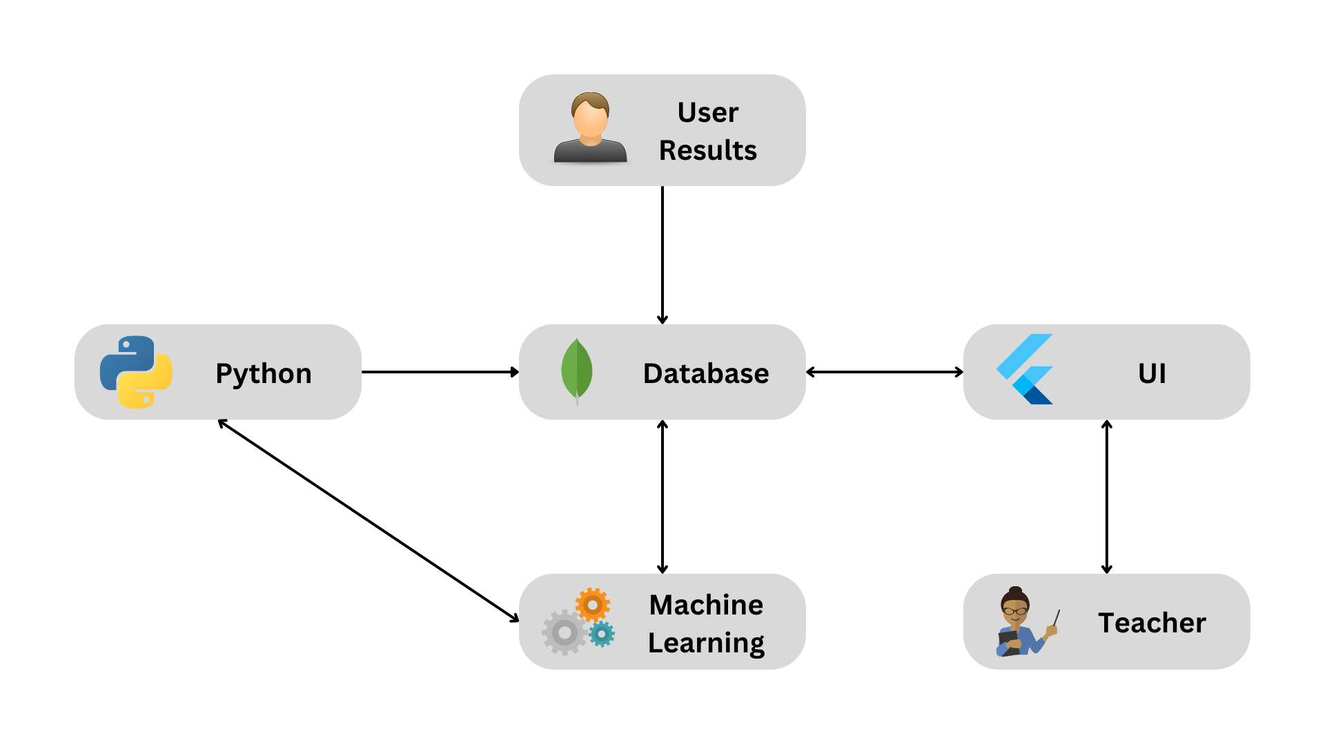
Methodology
System Diagram
IT20275006 | Lakpriya K.H.A.V | R24-109

Slide 40








Methodology
Technologies
IT20275006 | Lakpriya K.H.A.V | R24-109

Slide 41
Methodology
Requirements
Functional Requirements | Non-Functional Requirements
Kids can take interactive programming quizzes customized for grades 3-5 level | User-friendly and intuitive interface designs for kids and teachers
The system scores kid performance on quizzes | Grade and performance data is securely encrypted and protected
Adaptive grading algorithms analyze kid progress over time and adjust grade parameters accordingly | System provides high availability with minimal downtime
Teachers can access visual dashboards showing class performance analytics
Dashboards include customizable filters to focus data by topic, quiz, student, etc.
IT20275006 | Lakpriya K.H.A.V | R24-109

Slide 42
Methodology
Requirements
Software Requirements | User Requirements
Compatible web browsers: Chrome, Firefox | Customize quiz content and parameters
Server-side: Python/Django framework | Access data visualizations of class performance
Client-side: HTML5, CSS3, JavaScript, React | Gain insights to refine teaching methods
Data science: Pandas, Matplotlib, scikit-learn | Export reports for individual students or class
IT20275006 | Lakpriya K.H.A.V | R24-109

Slide 43
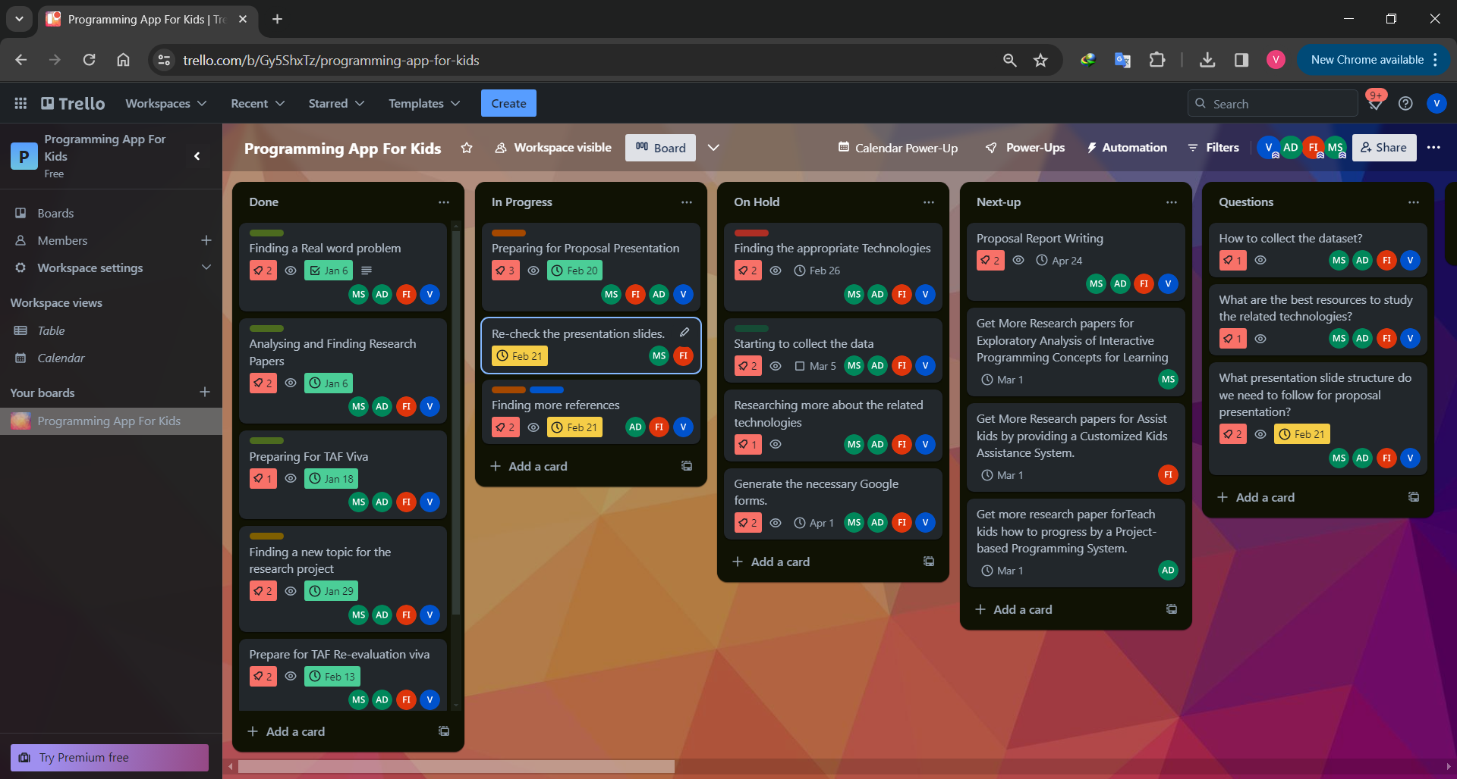
Methodology
IT20275006 | Lakpriya K.H.A.V | R24-109

Slide 44
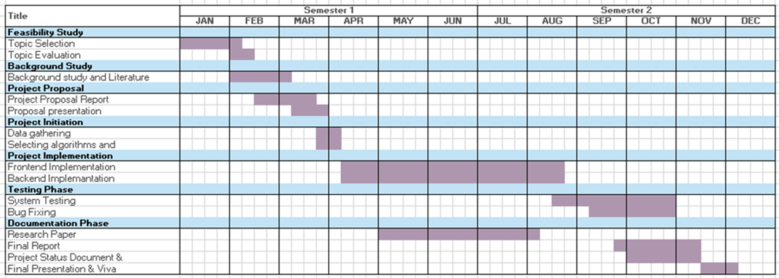
Gantt Chart
IT20275006 | Lakpriya K.H.A.V | R24-109

Slide 45
Supporting Items
Commercialization
Offer a subscription-based model
Licensing and Partnerships
Share on social media add
Make it shareable
Provide an accurate description of our product
IT20275006 | Lakpriya K.H.A.V | R24-109

Slide 46
Supporting Items
Budget
NO | Expenditure | Cost ($)
1 | Domain | 14.43$/M
2 | Hosting | 2.99$/M
3 | Traveling Expenses (4 Members ) | 12.84$/Trip
4 | Google Play Developer Fee | 25$ (One Time)
Total |  | 55.26$
IT20275006 | Lakpriya K.H.A.V | R24-109

Slide 47
References
[21] J. Brown et al., "Limitations of traditional exams in evaluating programming skills," Educ. Res. Rev., vol. 17, no. 2, pp. 195-208, 2020.
[22] J. Smith and A. Williams, "The impact of personalized learning platforms," Computers & Educ., vol. 152, Mar. 2021.
[23] S. Grinshpan, “Teaching programming using multimedia tools,” in Proc. 27th Int. Conf. Multimedia Modelling, 2021, pp. 112-118.
[24] K. Desmarais and R. Baker, “A review of learner and skill modeling in ILEs,” User Modeling and User-Adapted Interaction, vol. 22, pp. 9-38, 2012.
[25] Y. Li et al., “Application of reinforcement learning in educational games,” Entertainment Computing, vol. 25, pp. 10-20, Jan. 2019.
[26] M.V. Dominguez et al., "Gamifying intelligent environments," in Proc. 6th Int. Conf. Intelligent Environments, 2020, pp. 114-117.
[27] J. Cirillo et al., “Using EDM for early identification of at-risk students,” in Proc. AAAI Conf. Artificial Intelligence, 2020, pp. 1373-1379.
[28] A. Johnson, B. Evans, and C. Thompson, "QuizGuide: Increasing learning gain in introductory programming with an intelligent tutoring system," Journal of Educational Computing Research, vol. 54, no. 7, pp. 967-985, 2016.
[29] M. Wilson and A. Thomas, "Adaptive personalized learning system for block-based coding skills," in Proc. 7th ACM Conf. Learning at Scale, New York, NY, USA, 2019.
[30] R. Patel and Y. Chen, "SkillCheck: An Adaptive Testing Platform for Data Structures Concepts," in Proc. 51st ACM Technical Symposium on Computer Science Education, New York, NY, USA, 2020.
IT20275006 | Lakpriya K.H.A.V | R24-109

Slide 48

IT21084522 | DISSANAYAKE A. L.
Software Engineering Specialization
IT21084522 | Dissanayake A. L. | R24-109

Slide 49

Introduction
This study delves into the transformative impact of a Project-Based Programming Learning App on elementary school students in grades 3-5. The research focuses on key elements such as skill development, practical application, real-time language translation for peer feedback, and group problem-solving. Additionally, it explores the machine learning model's efficacy in tailoring individual and group projects. With a blend of quantitative and qualitative approaches, the study aims to uncover long-term learning outcomes, assess user satisfaction, gauge parental involvement, and understand the influence of ethical considerations on student engagement and learning
IT21084522 | Dissanayake A. L. | R24-109

Slide 50

Research Questions ?
Does the Project-Based Programming Learning App impact
elementary students' skills?
What's the app's role in practical application and real-time language translation for peer feedback and group problem-solving?
How effective is the machine learning model in analyzing students and assigning relevant projects?
What are the long-term outcomes and user satisfaction levels, and how does parental involvement contribute?
How do ethical coding consideration elements influence student learning?
IT21084522 | Dissanayake A. L. | R24-109

Slide 51
Research Gap
Research Papers | Methodology | Technology | Gap | Solution
Project-Based Learning Approach for Teaching Mobile Application Development Using Visualization Technology [31] | No | No | Lacks assessing students and recommending projects | The solution will include a model that rates the student and recommend a suitable project
App-based learning for kindergarten children at home [32] | Yes | Yes | No real-time translation or peer communication | The solution will make it easier for students to communicate with peers in many languages
A review of Project-Based Learning (PBL) and Computational Thinking (CT) in teaching and learning [33] | Yes | No | Lacks uncover long-term learning outcomes, assess user satisfaction, gauge parental involvement | The solution will assess long-term learning outcomes, user satisfaction and how parental involvement influences
IT21084522 | Dissanayake A. L. | R24-109

Slide 52

Specific and Sub Objectives
Develop a system that assesses the improvement in practical application and group problem-solving abilities among elementary school students participating in the project-based programming learning app, utilizing specific metrics to measure collaborative problem-solving effectiveness.
Provide a platform for kids to have peer communication and take part in group activities.
Allow parents and teachers to submit their feedback.
Real-time translations which would translate the input from each student.
Improving Skill development and Practical Application of kids.
Evaluating and assessing the overall impact of the system.
IT21084522 | Dissanayake A. L. | R24-109

Slide 53
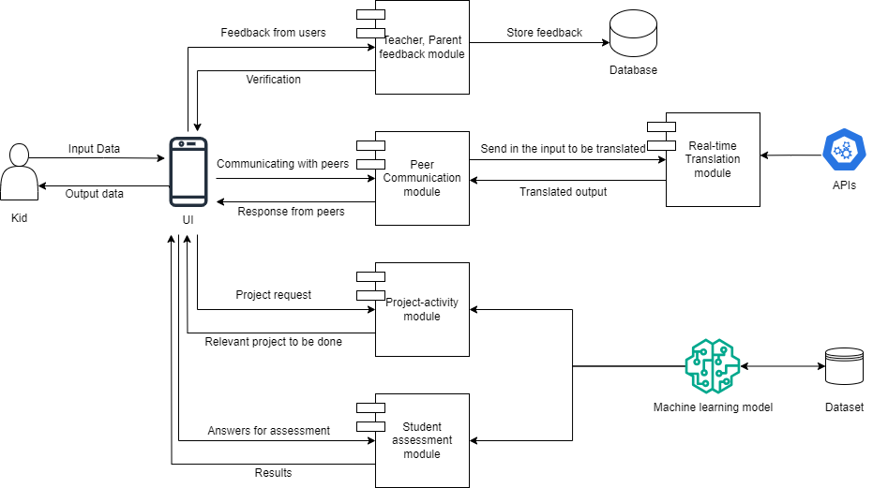
Methodology
System Diagram
IT21084522 | Dissanayake A. L. | R24-109

Slide 54





Methodology Cont’d
Technologies Used
Flutter
Node JS/ Springboot
MongoDB
TensorFlow
Microsoft Translator API
React
IT21084522 | Dissanayake A. L. | R24-109

Slide 55
Methodology Cont’d
System Requirements
Functional Requirements | Non-Functional Requirements
User should be able to use project-based learning modules | Usability
User should be able to use real-time language translation | Performance
User should be able to collaborate and communicate with a group of kids | Scalability
User should be able to assess their skills | Security
IT21084522 | Dissanayake A. L. | R24-109

Slide 56

Methodology Cont’d
Personal Requirements
Technical Proficiency
Problem-solving Skills
Understanding of Educational Principles.
Data Analysis Skills
Collaborative Problem-Solving
IT21084522 | Dissanayake A. L. | R24-109

Slide 57
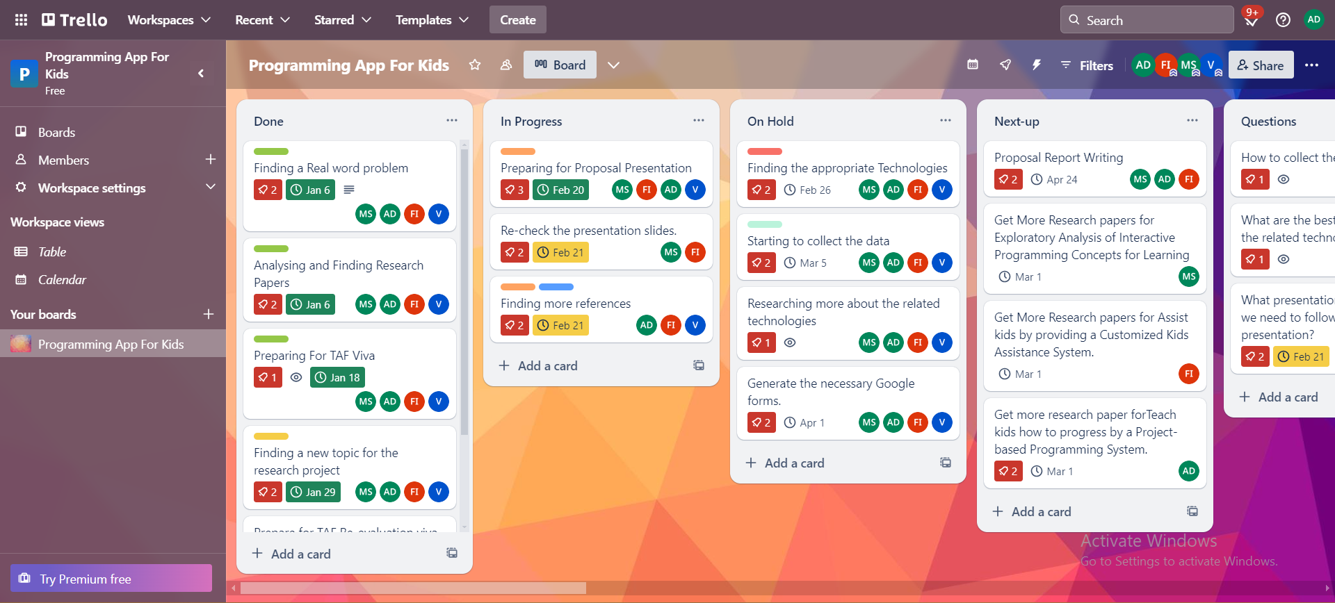
Methodology Cont’d
IT21084522 | Dissanayake A. L. | R24-109

Slide 58
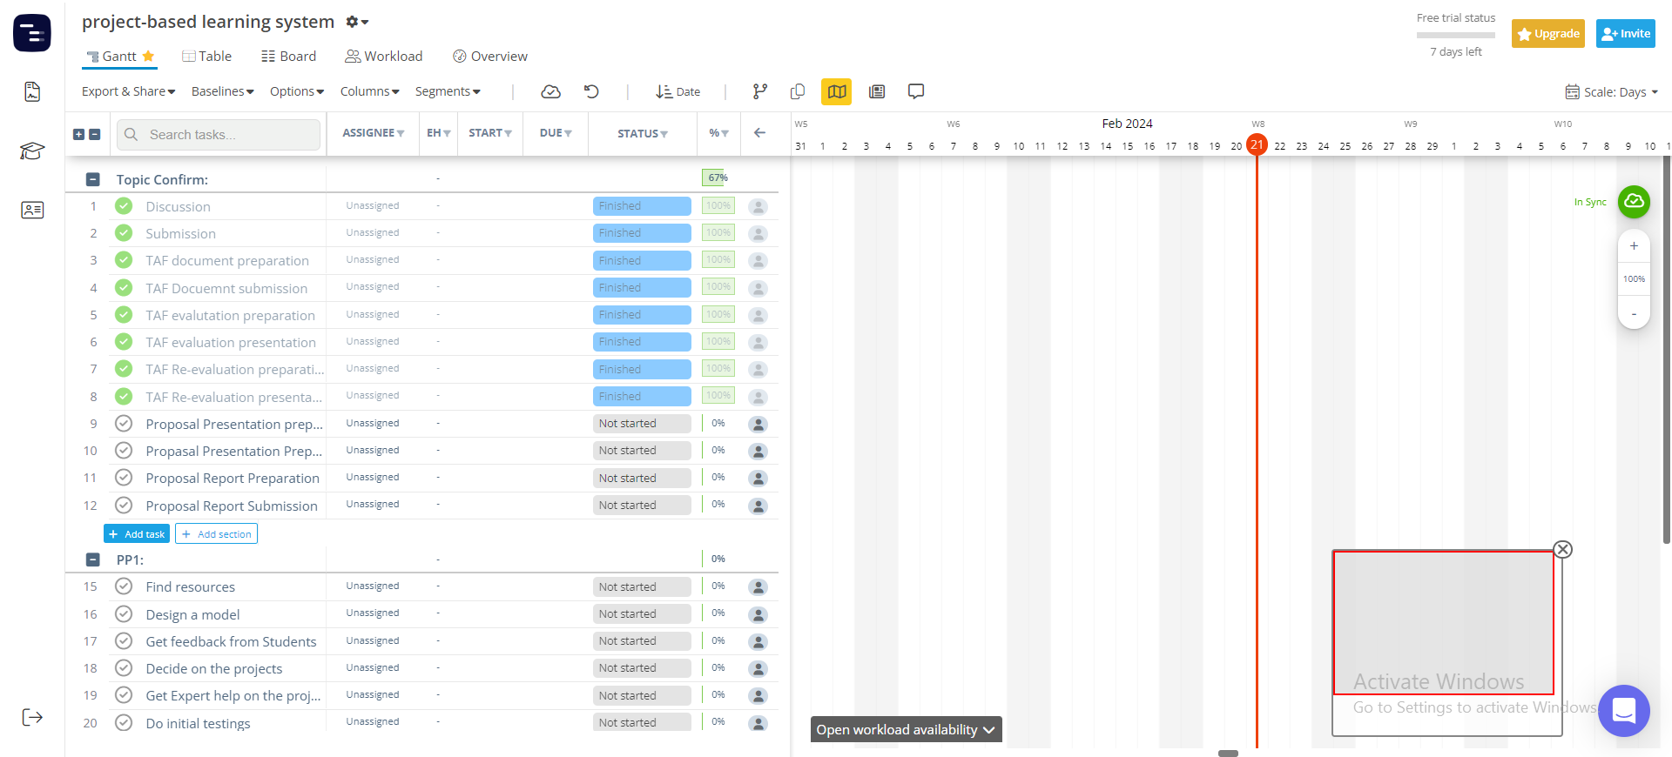
Methodology Cont’d
Gantt Chart
IT21084522 | Dissanayake A. L. | R24-109

Slide 59
Supporting Items
Commercialization
Offer a subscription-based model
Licensing and Partnerships
Share on social media add
Make it shareable
Provide an accurate description of our product
IT21084522 | Dissanayake A. L. | R24-109

Slide 60
Supporting Items
Budget
NO | Expenditure | Cost ($)
1 | Domain | 14.43$/M
2 | Hosting | 2.99$/M
3 | Traveling Expenses (4 Members ) | 12.84$/Trip
4 | Google Play Developer Fee | 25$ (One Time)
Total |  | 55.26$
IT21084522 | Dissanayake A. L. | R24-109

Slide 61
References
[31] “(PDF) Project-Based Learning Approach for teaching mobile application ...,” Project-Based Learning Approach for Teaching Mobile Application Development Using Visualization Technology, https://www.researchgate.net/publication/340901247_Project-Based_Learning_Approach_for_Teaching_Mobile_Application_Development_Using_Visualization_Technology (accessed Feb. 20, 2024).
[32] Author links open overlay panelAslina Saad a et al., “A review of Project-Based Learning (PBL) and Computational Thinking (CT) in teaching and learning,” Learning and Motivation, https://www.sciencedirect.com/science/article/abs/pii/S0023969022000224 (accessed Feb. 21, 2024).
[33] F. Niklas, E. Birtwistle, A. Wirth, T. Schiele, and A. Mues, “App-Based Learning for Kindergarten Children at Home (learning4kids): Study protocol for cohort 2 and the school assessments - BMC pediatrics,” BioMed Central, https://bmcpediatr.biomedcentral.com/articles/10.1186/s12887-022-03737-w (accessed Feb. 21, 2024).
IT21084522 | Dissanayake A. L. | R24-109

Slide 62
References
[1] https://www.bbc.com/news/world-61028138
[2] https://www.ncbi.nlm.nih.gov/pmc/articles/PMC9212225/
[3] https://icts.io/2023/09/08/top-3-outsourcing-countries-in-asia-india-philipines-and-vietnam
[4] https://timesofindia.indiatimes.com/india-fastest-growing-open-source-contributor-github/articleshow/81741376.cms?from=mdr

Slide 63
Thank-You

